Slide 1
Trans-Tasman Quarantine Free Travel (QFT) datapack
2 June 2021

Slide 2
Data sources and contact information
MBIE Consumer spend data (updated to 30 May 2021):
https://mbienz.shinyapps.io/card_spend_covid19/
Stats NZ Daily border crossings (updated to 25 May 2021):
https://www.stats.govt.nz/indicators/international-travel-provisional\
Weekly visitor arrivals (updated to 9 May 2021):
https://www.stats.govt.nz/indicators/international-travel-provisional\

Slide 3
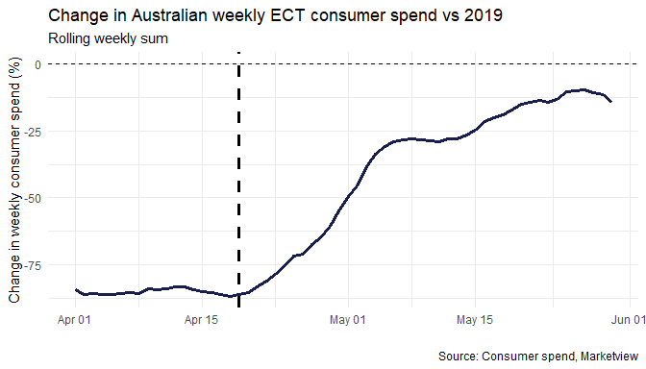
Australian spending is still below historical levels
After the opening of Trans-Tasman Quarantine Free Travel, Australian card spending has steadily increased to 14% below 2019 levels in the week-ended 30 May.

Slide 4
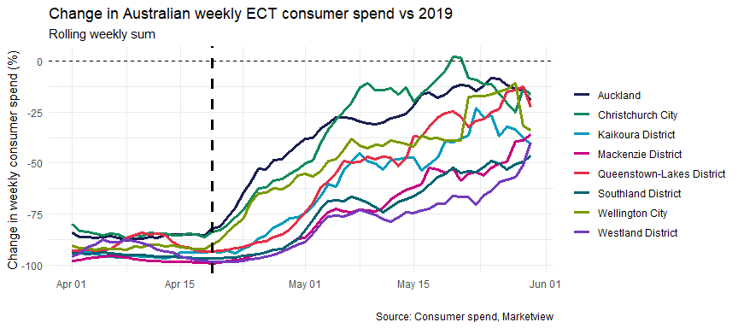
Australian spend has recovered more in larger cities
Australian spend in large cities has recovered the most towards 2019 levels. In the week-ended 30 May, Australian spend in Christchurch, Auckland Wellington was down 16%, 19% and 34% respectively.
International tourism hotspots, such as Southland (down 47%), Kaikōura (down 41%), Westland (down 40%), and Mackenzie (down 36%) have recovered slower. Queenstown however is recovering better when compared to 2019, down 22%.
These differences are likely due to new arrivals staying in the cities they arrived in and visiting friends and family, rather than performing traditional tourism activities in the regions.

Slide 5
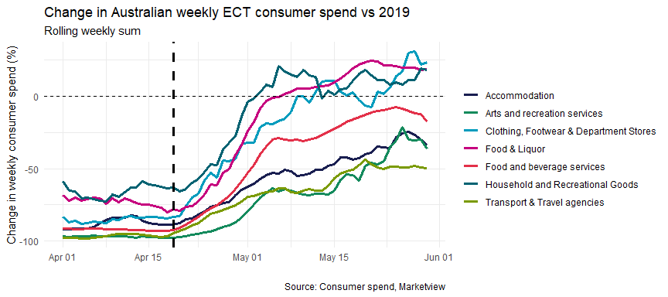
Australians spend less in tourism-related industries
Australian spend in industries such as footwear & department stores’ (up 23%), ‘food and liquor’ (up 19%), and ‘household and recreational goods’ (up 18%) is at levels above those in 2019, for the week-ended 30 May.
Tourism-related industries such as ‘transport and travel agencies’ (down 50%), ‘arts and recreational services’ (down 36%), accommodation (down 34%) are not faring as well.
This reflects our expectations that initial travellers from Australia are business travellers and people visiting friends and relatives, rather than holidaymakers.

Slide 6
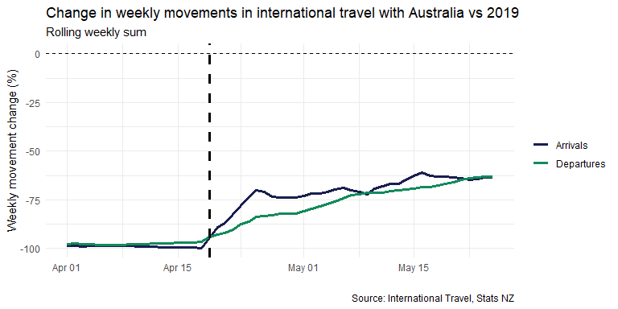
Both total arrivals and departures from Australia are still down on 2019 levels
In the week-ended 25 May, total arrivals and departures from Australia were both 63% down on 2019 levels

Slide 7
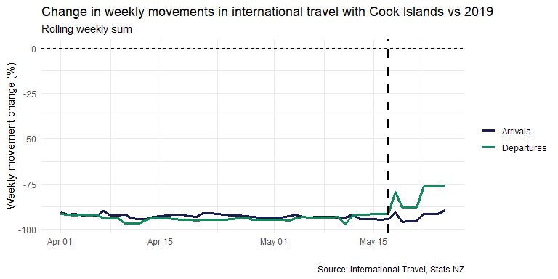
Departures to the Cook Islands still 76% down on 2019
In the week-ended 25 May, departures to the Cook Islands were 76% down on 2019 levels, and arrivals were down 90%.

Slide 8
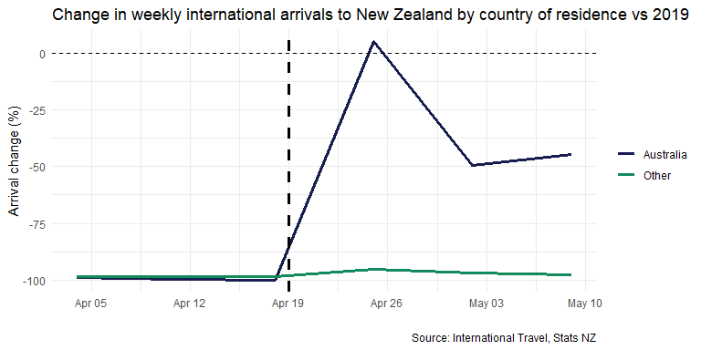
Australian visitors to New Zealand recovered to 45% down on 2019 levels in the latest week
In the week-ended 9 May, Australian visitor arrivals were down 45% on 2019 levels, and the number of visitors from all other countries were down 98%.

Slide 9
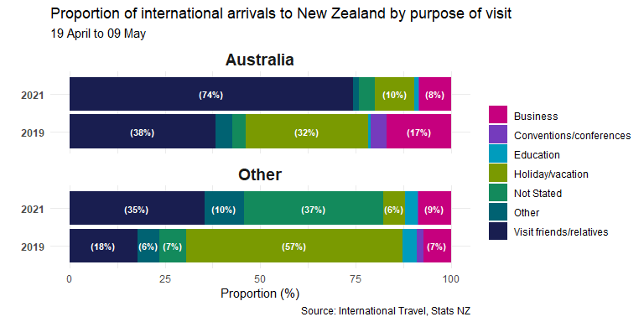
As expected, the majority of early Australian visitor arrivals after QFT started were visiting friends and relatives
In the first 3 weeks of QFT with Australia, 74% of Australian arrivals and 38% of visitors from all other countries were visiting friends and relatives (VFR) in NZ.
This is a lot higher than the same time in 2019, where VFR arrivals accounted for 35% of Australian visitors and 18% of all other visitors.

Slide 10
Contact us
Ministry of Business, Innovation & Employment
15 Stout Street, PO Box 1473,
Wellington 6140, New Zealand.
Michael.Webster@mbie.govt.nz | +64 27 478 8325
www.mbie.govt.nz
Notes:
Sample last page

